Slide 1

HOME RENOVATION VALUE INFERENCE
SHAYAN ABDUL KARIM KHAN
11/18/2022

Slide 2
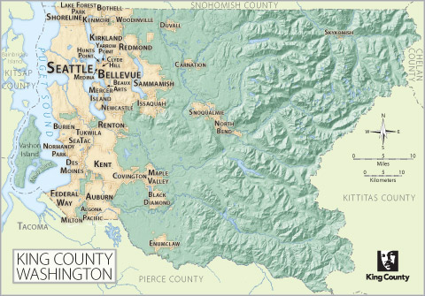

Slide 3





What kind of renovations increase house value?
Magnitude of Impact of the renovations oh house value

Slide 4


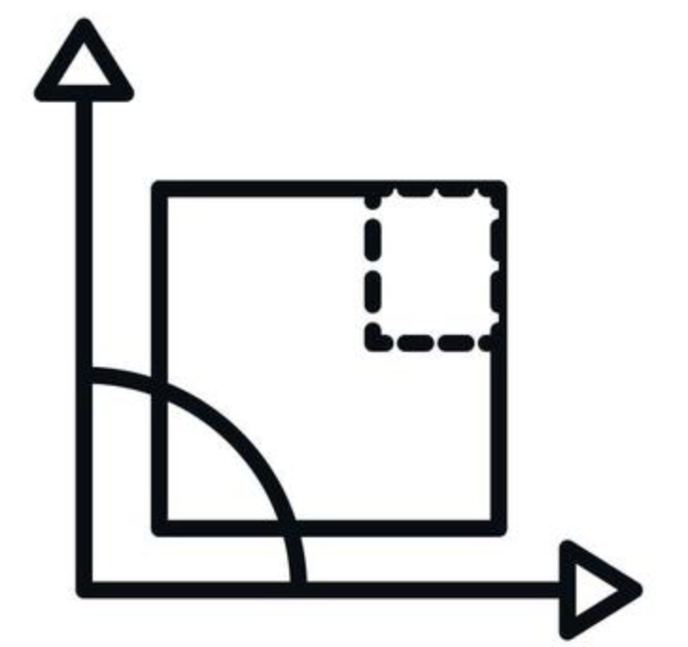
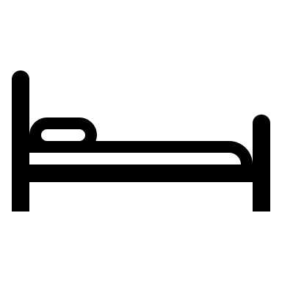

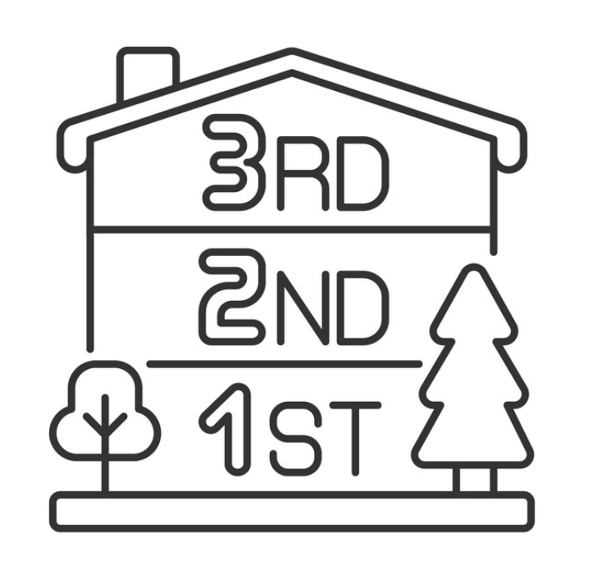
SQ FOOTAGE LIVING
GRADE AND CONDITION
BATHROOMS
BEDROOMS
HOUSE PRICE
FLOORS

Slide 5
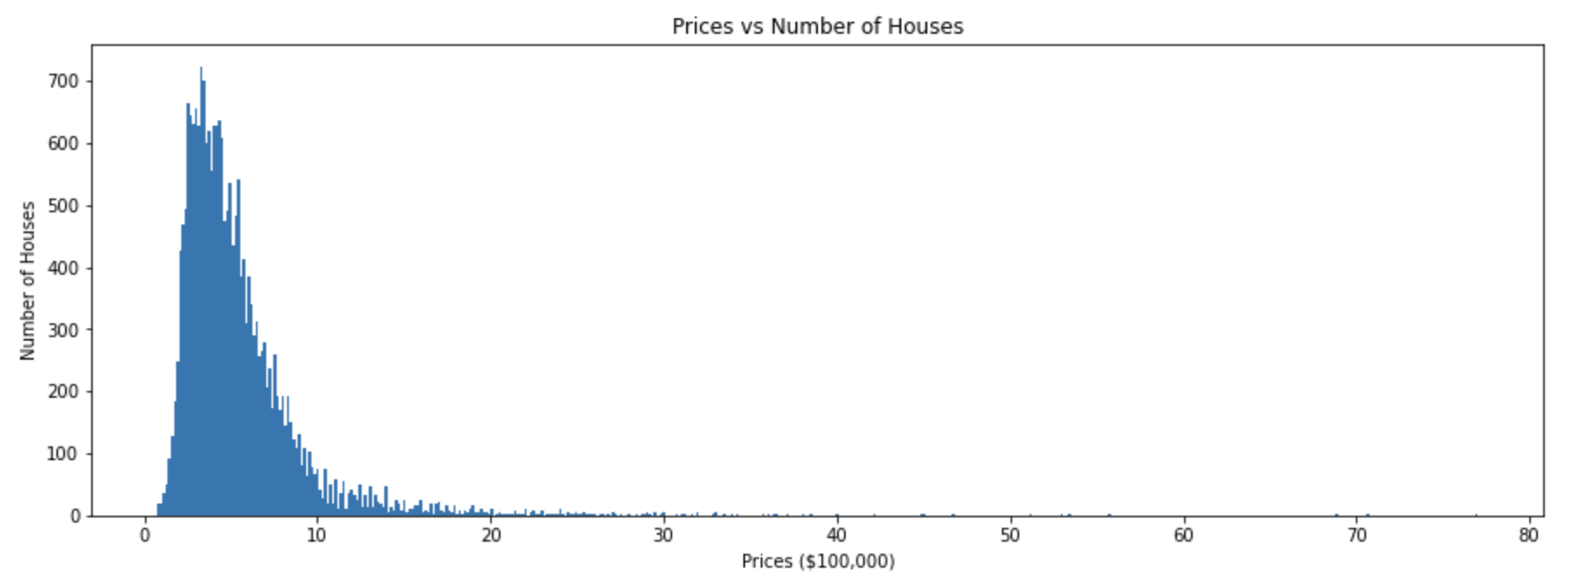
HOUSE PRICE
Houses over $1 million were not included

Slide 6
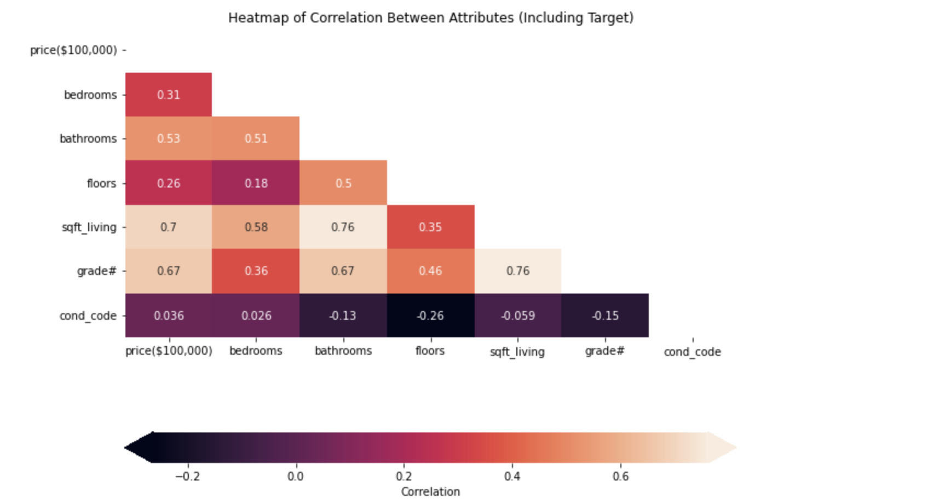
SQFT LIVING HIGHEST CORRELATION
Notes:
Correlatiion sllide

Slide 7
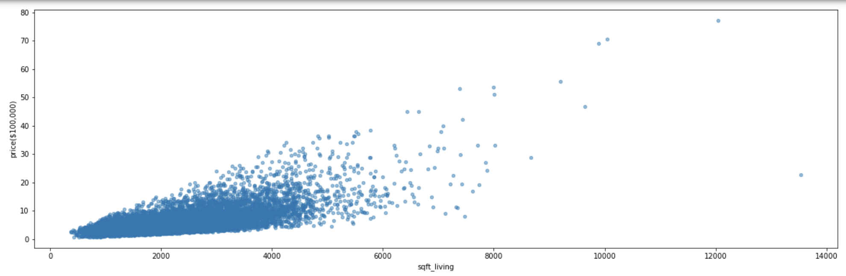
SQ FOOTAGE LIVING
Houses over 6000 sq ft were not included

Slide 8
SQ FOOTAGE LIVING
GRADE
CONDITION
HOUSE PRICE

Slide 9
1% increase results in 1.5% increase in price
Increasing floors, bedrooms, expanding decks
Fair and Low Average have negative impacts on the house price
Good Grade has a multiple of 0.86
Very Good multiplier 2.87
Excellent multiplier 3.64
Good condition increases the price by a multiple of 0.35
Very good condition increased the price by a multiple of 0.94
ERROR OF $1.4K IN MODEL PREDICTIONS, UNDER-PREDICTION
Notes:
Regression results:
What kind of reenovations increase home value
Wwhat kind of an impact do these renovations have?

Slide 10


RECOMMENDATION
INCREASING FLOORS, BEDROOMS, AND EXPANDING LIVING QUARTERS
PROPERLY FUNCTIONAL DEVICES WITH NO OBVIOUS MAINTENANCE REQUIRED
FOR BIG CHANGES, COMPLEETE REMODELLING PROJECTS
RENOVATIONS TOWARDS EXTRA AMENITIES OR LUXURIOOUS CHANGES

Slide 11


NEXT STEPS
EVALUATE ZIPCODE SPECIFIC DATA
EVALUATE YEARLY MARKET TRENDS
EVALUATE HOME-TYPE SPECIFIC RENOVATIONS
EVALUATE RETURN ON INVESTMENT

Slide 12
QUESTIONS?

Slide 13
HOME RENOVATION VALUE INFERENCE
SHAYAN ABDUL KARIM KHAN
11/18/2022

Slide 14
BACK UP

